Slide 1
MUSIC GENERATION WITH RNN
Presented By:
SARUMATHI E[513121104038]
THANTHAI PERIYAR GOVERNMENT INSTITUTE OF
TECHNOLOGY,
VELLORE .

Slide 2
AGENDA:
Problem Statement
Project Overview
End Users
Dataset Overview
Data Preprocessing
Model Architecture
Model Training
Music generation
Results & Conclusion

Slide 3
Problem Statement
Develop an algorithm using Recurrent Neural Networks (RNNs) to generate novel musical compositions based on a given dataset of existing music. The goal is to create a model capable of learning the underlying patterns, structure, and style of the music from the dataset and generating new sequences of musical notes that sound coherent and musically pleasing.

Slide 4
Project Overview Objective: The objective of this project is to develop an algorithm using RNNs to generate novel musical compositions. By leveraging a dataset of existing music, the algorithm will learn the underlying patterns, styles, and characteristics of the music and produce new compositions that capture the essence of the original dataset while introducing unique elements of creativity.

Slide 5
End Users
Music Producers:
Seeking innovative compositions for albums.
Sound Designers:
Exploring new audio experiences for multimedia.
Artists:
Wishing to experiment with novel music styles.

Slide 6
Dataset Overview
We use the MAESTRO Version 2 dataset, a comprehensive collection of MIDI files capturing classical piano performances, fuels our music generation project with RNNs. This dataset offers a diverse range of musical compositions, enabling our model to learn intricate patterns and structures. With its rich repository spanning various styles and complexities, MAESTRO Version 2 serves as the cornerstone for training our AI system to generate captivating and expressive music sequences.

Slide 7
Data Preprocessing
Steps:
Conversion of MIDI notes to numerical representation.
Creation of sequences of notes for input and target notes.
Normalization of input sequences and conversion of output to one-hot encoding.

Slide 8
Model Architecture
Design and implement an RNN-based model capable of learning temporal dependencies in music sequences. The model architecture will include components such as LSTM layers to capture long-range dependencies and dropout layers to prevent overfitting.
Through this architecture, our RNN-based system can effectively learn intricate patterns and structures from the input data, enabling the generation of coherent and expressive musical compositions.

Slide 9
Model Training
Train the RNN model on the preprocessed music data to learn the patterns and structures of the compositions. Utilize optimization algorithms and loss functions tailored for sequence generation tasks to maximize the model's learning capabilities.
Through iterative epochs, the model learns to minimize the discrepancy between predicted and actual musical sequences, enhancing its ability to generate novel compositions.

Slide 10
Music Generation
Develop a mechanism to generate new music sequences using the trained RNN model. Users will have the option to input initial sequences or allow the model to generate completely novel compositions based on learned patterns.
Emphasize the role of providing an initial sequence to start the generation process.
Discuss the flexibility of choosing a random sequence from the dataset or creating a custom initial sequence.

Slide 11
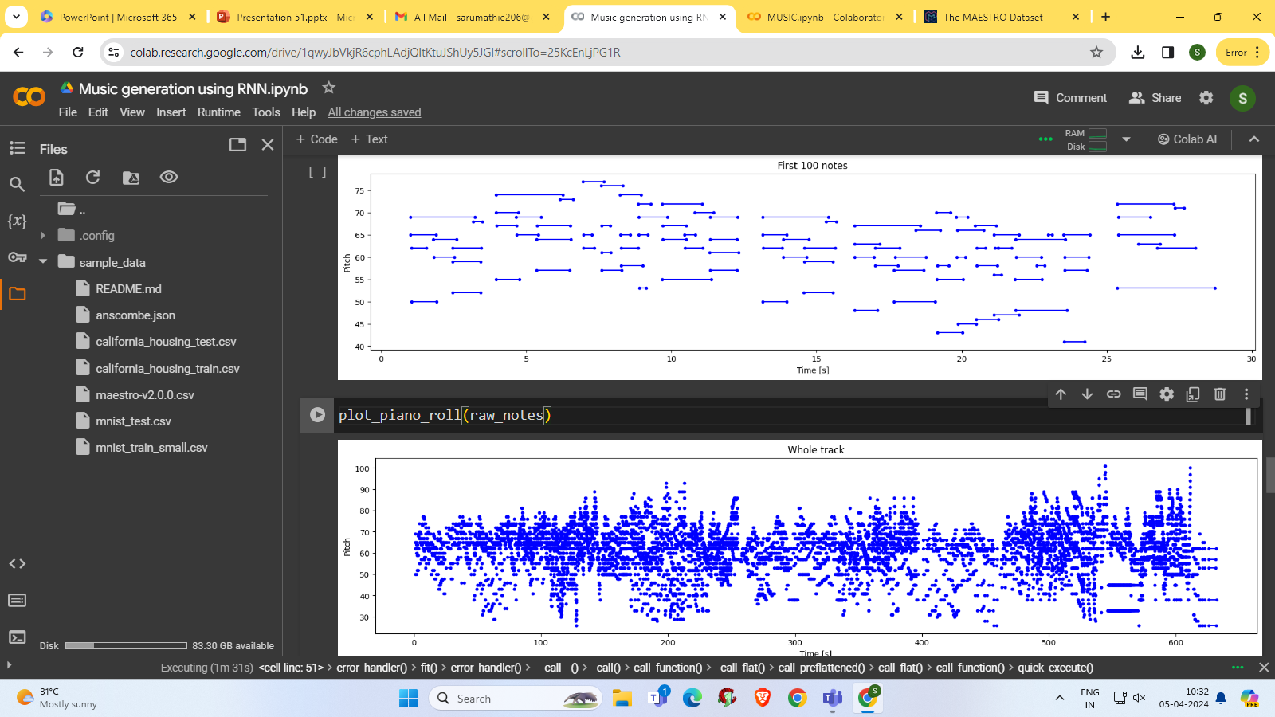
Results

Slide 12
Conclusion
In conclusion, our project showcases the potential of Recurrent Neural Networks (RNNs) in music generation, leveraging the MAESTRO Version 2 dataset to create captivating compositions. Through meticulous data preprocessing, model architecture design, and training, our RNN-based system can generate diverse and expressive musical sequences
we aim to inspire creativity and innovation at the intersection of artificial intelligence and music, opening doors to new realms of artistic exploration and expression.

